Slide 1
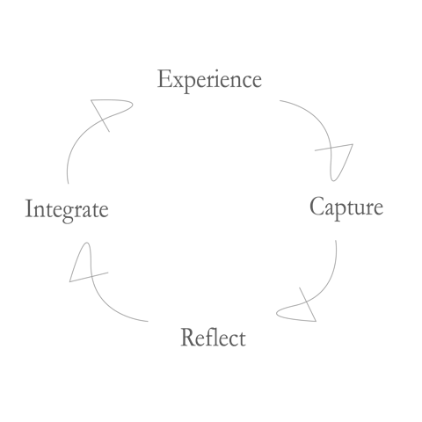

Slide 2
Experience Practicing Mindfulness of the Body
Week One
15 minutes/day
Daily Instructions
Experience a body scan.
Capture what occurred during the practice. As yourself: What’s here now? This is pure experience you’re reporting, like in class. Maybe you want to draw a picture instead of use words.
Reflect – Introduce thought. Any surprises? Obstacles? Confusion? Where did you practice and at what time? Any emotions arising?
Integrate – What might you bring forward as a result of this practice? Anything to be on the lookout for? Did you learn anything?

Slide 3
Tuesday, June 7
Capture
Reflect
Integrate
Week One
Wednesday, June 8
Capture
Reflect
Integrate

Slide 4
Thursday, June 9
Capture
Reflect
Integrate
Week One
Friday, June 10
Capture
Reflect
Integrate

Slide 5
Saturday, June 11
Capture
Reflect
Integrate
Week One
Sunday, June 12
Capture
Reflect
Integrate

Slide 6
Monday, June 13
Capture
Reflect
Integrate
Week One
Finally, name a few things/people/situations you are grateful for?
Describe something you’re looking forward to?
Did you by chance notice or perform an act generosity or kindness? Maybe be on the lookout for them. We’ll talk more about them next week.
What were my 5 character strengths? Go to: https://www.viacharacter.org/

