Slide 1
Mindfulness for Financial Advisors
Created and shared by Mary Martin, PhD
Class Two
Home Practice

Slide 2
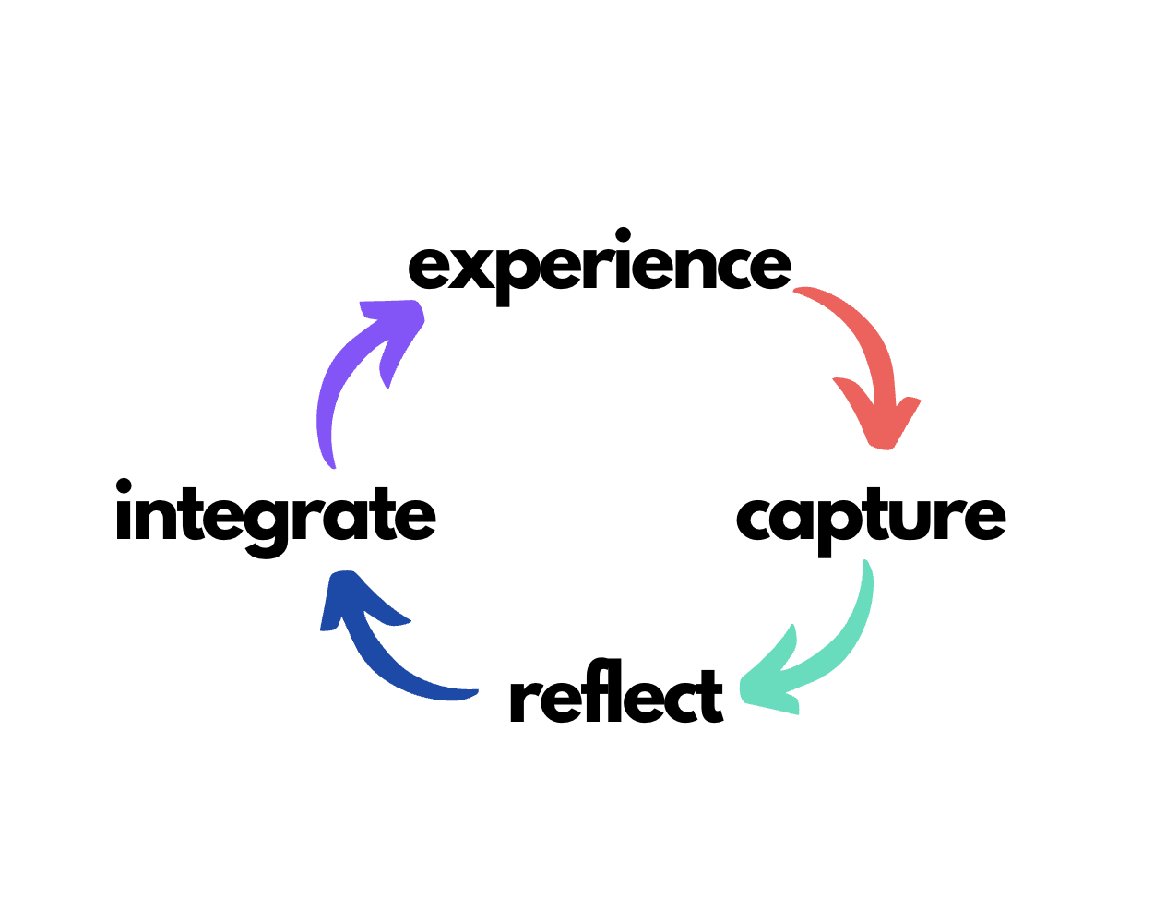

Slide 3
Experience Focused Attention
Class Two
15 minutes/day
Daily Instructions
Experience a focused attention practice.
Capture what occurred. As yourself: What’s here now? This is pure experience you’re reporting, like in class. Were you able to focus for a few moments? It’s not a big deal if you weren’t — you’re in training!
Reflect – Introduce thought. Any surprises? Obstacles? Confusion? Where did you practice and at what time? Any emotions arising? Is there something your mind kept going back to? Planning? Worrying?
Integrate – What might you bring forward as a result of this practice? Anything to be on the lookout for? Did you learn anything?

Slide 4
Tuesday, October 3
Capture
Reflect
Integrate
Class Two
Wednesday, October 4
Capture
Reflect
Integrate

Slide 5
Thursday, October 5
Capture
Reflect
Integrate
Class Two
Friday, October 6
Capture
Reflect
Integrate

Slide 6
Saturday, October 7
Capture
Reflect
Integrate
Class Two
Sunday, October 8
Capture
Reflect
Integrate

Slide 7
Monday, October 9
Capture
Reflect
Integrate
Class Two
Tuesday, October 10
Capture
Reflect
Integrate

Slide 8
Wednesday, October 11
Capture
Reflect
Integrate
Class Two
Thursday, October 12
Capture
Reflect
Integrate

Slide 9
Friday, October 13
Capture
Reflect
Integrate
Class Two
Saturday, October 14
Capture
Reflect
Integrate

Slide 10
Sunday, October 15
Capture
Reflect
Integrate
Class Two
Finally, name a few things/people/situations you are grateful for.
Describe something you’re looking forward to.
Did you by chance notice or perform an act generosity or kindness? Maybe be on the lookout for them. We’ll talk more about them next week.
If you didn’t do the character strengths, go to: https://www.viacharacter.org/ I promise we’ll talk about them!

